Slide 1
DBMS
SQL Commands

Slide 2
SQL Commands
A DBMS must provide appropriate languages and interfaces for each category of users to express database queries and updates. Database Languages are used to create and maintain database on computer. There are large numbers of database languages like Oracle, MySQL, MS Access, dBase, FoxPro etc. SQL statements commonly used in Oracle and MS Access can be categorized as data definition language (DDL), data control language (DCL) and data manipulation language (DML).

Slide 3
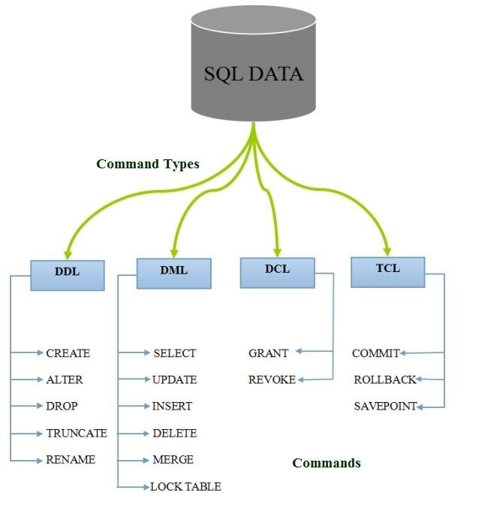

Slide 4
Data Definition Language(DDL)
It is a language that allows the users to define data and their relationship to other types of data. It is mainly used to create files, databases, data dictionary and tables within databases.
It is also used to specify the structure of each table, set of associated values with each attribute, integrity constraints, security and authorization information for each table and physical storage structure of each table on disk.

Slide 5
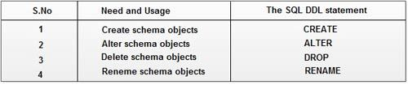
The following table gives an overview about usage of DDL statements in SQL-

Slide 6
Data Manipulation Language(DML)
It is a language that provides a set of operations to support the basic data manipulation operations on the data held in the databases. It allows users to insert, update, delete and retrieve data from the database. The part of DML that involves data retrieval is called a query language.

Slide 7
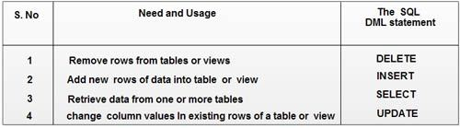
The following table gives an overview about the usage of DML statements in SQL:

Slide 8
Data Control Language(DCL)
DCL statements control access to data and the database using statements such as GRANT and REVOKE. A privilege can either be granted to a User with the help of GRANT statement. The privileges assigned can be SELECT, ALTER, DELETE, EXECUTE, INSERT, INDEX etc. In addition to granting of privileges, you can also revoke (taken back) it by using REVOKE command.

Slide 9

The following table gives an overview about the usage of DCL statements in SQL:
GRANT: allow specified users to perform specified tasks.
REVOKE: cancel previously granted or denied permissions.

Slide 10
Transaction Control Language(TCL)
Transaction Control Language commands are used to manage transactions in the database. These are used to manage the changes made by DML-statements. It also allows statements to be grouped together into logical transactions.

Slide 11
Examples of TCL commands –
COMMIT: Commit command is used to permanently save any transaction into the database.
ROLLBACK: This command restores the database to last committed state. It is also used with savepoint command to jump to a savepoint in a transaction.
SAVEPOINT: Savepoint command is used to temporarily save a transaction so that you can rollback to that point whenever necessary.

Slide 12
Thank YOU

